Slide 1

Vintronics: Retro Product E-commerce Platform
By:-
M. Smrity Reddy
(MCA 4th Semester)
Reg No:- 2305260010

Slide 2
Contents
Introduction
Project Overview
Competitor Analysis
Technology Stack
Why These Technologies
Component Breakdown
Benefits
Screenshot of Our Website
Future Enhancement
Challenges and Solutions
Security Features
User Roles
Conclusion

Slide 3
Introduction
"Our project is a Vintronics - Retro Gadget E-Commerce Website designed to offer a nostalgic shopping experience for vintage tech enthusiasts. Built using HTML, CSS, JavaScript, Java, Spring Boot, and MySQL, the platform provides a seamless interface for browsing and purchasing classic gadgets. It features secure authentication, an intuitive UI, and efficient database management to ensure smooth transactions. The goal is to connect collectors and enthusiasts with rare and timeless tech products."

Slide 4
Project Overview
Buy & Sell Vintage Electronics – A dedicated marketplace for collectors and tech lovers to explore and
trade rare gadgets.
User-Friendly Interface – Built with modern technologies like HTML, CSS, JavaScript, Java, Spring Boot,
and MySQL for an intuitive and engaging experience.
Secure Transactions – Ensuring safe payments and data protection for a trustworthy shopping experience.
Advanced Search & Filters – Easily browse products with smart filtering options based on era, brand,
and category.
Community & Reviews – Users can share reviews, ratings, and insights to help others make informed
purchases.

Slide 5
Competitor Analysis
Competitors:
eBay, Etsy, and niche retro marketplaces.
Strengths: Large inventory, established brands.
Weaknesses: Lack of a dedicated retro e-commerce experience.

Slide 6
Technology Stack
Software Requirement:-
Hardware Requirement:-
Backend: Spring Boot, Java.
Frontend: HTML, CSS, JavaScript.
Database: MySQL.
Display: 1920x1080 resolution Monitor.
Processor: Intel Core i5 or higher.
Network: Internet connectivity or Wi-Fi.
Storage: At least 256GB SSD.
RAM: 8GB or higher.

Slide 7
Why These Technologies?
Spring Boot: Fast, secure, and scalable backend with RESTful APIs for seamless communication.
JavaScript & CSS: Responsive, dynamic UI ensuring an interactive and smooth user experience.
MySQL: Reliable relational database for efficient data storage and management.
HTML: Structured and semantic web pages for better accessibility.
Spring Security: Robust authentication and authorization to ensure data privacy and secure transactions.
Hibernate: Efficient ORM framework for seamless database operations and query optimization.
REST APIs: Enables smooth integration between frontend and backend for dynamic content updates.
Payment Gateway Integration: Secure online transactions for a hassle-free checkout experience.

Slide 8
Component Breakdown
User Management
Category Management
Product Management
Order Processing
Payment Integration
Admin Dashboard
Seller Dashboard

Slide 9
Benefits
Eco-Friendly Approach – Encourages sustainable tech usage by promoting the resale and reuse of
vintage electronics.
Exclusive Collectible Listings – Offers a dedicated section for rare and limited-edition retro gadgets.
Auction & Bidding System – Allows users to bid on rare vintage items, making the buying process
more engaging.
Loyalty & Reward System – Users earn points or discounts for frequent purchases and active participation.
Social Media Integration – Enables users to share their favorite finds or sales on platforms like
Facebook and Instagram.
Multilingual Support – Expands accessibility by offering content in multiple languages for a global audience.
Affiliate & Referral Programs – Encourages users to invite friends and earn incentives, boosting platform
growth.

Slide 10
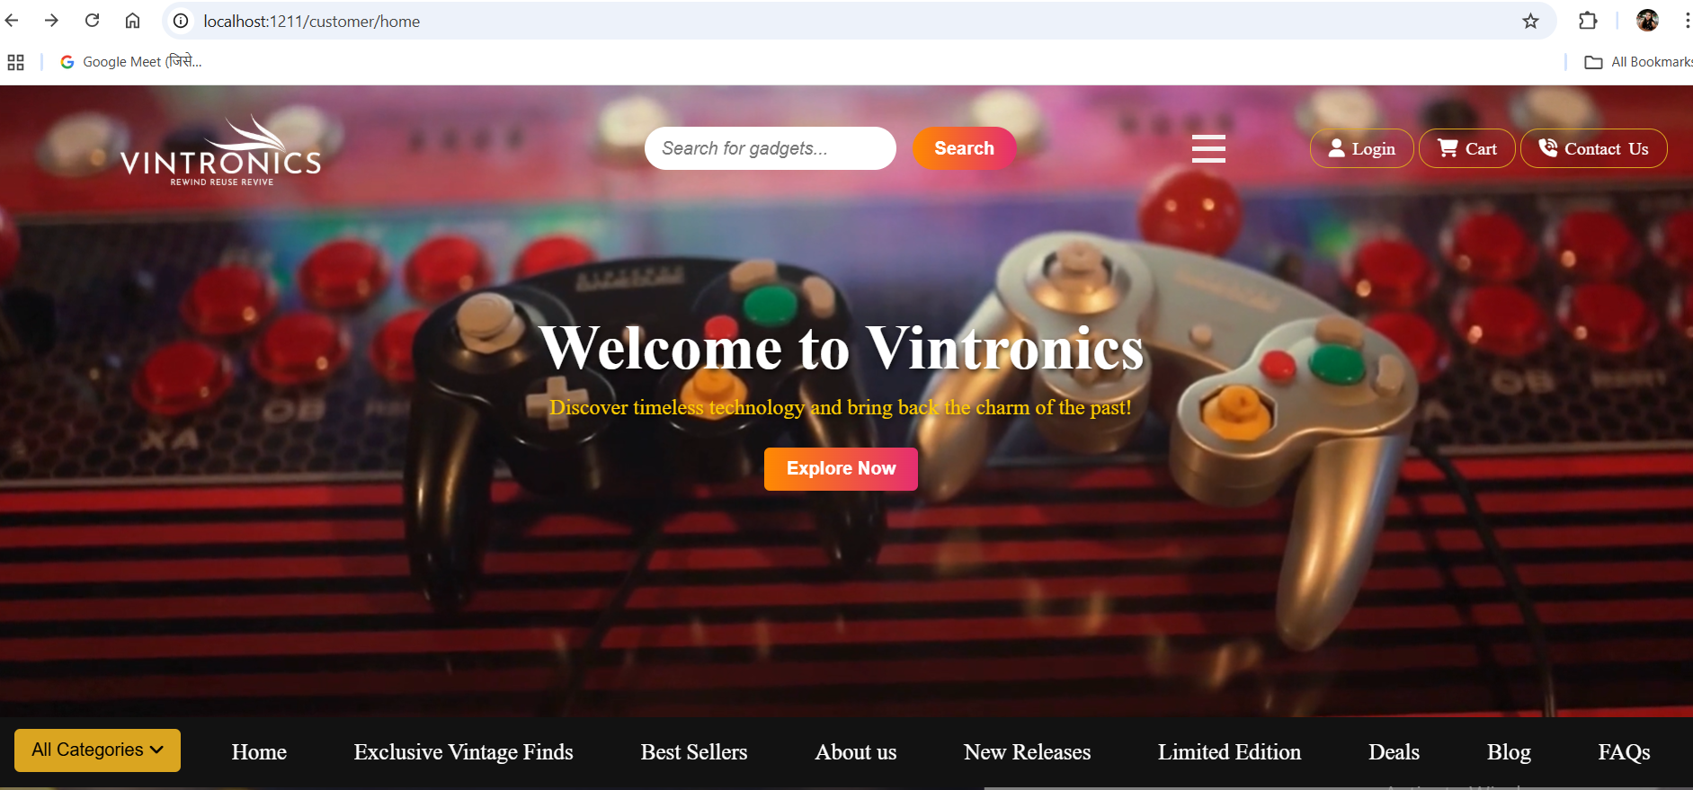
The landing page of Vintronics features an eye-catching, user-friendly design that highlights trending retro gadgets, seamless navigation, and quick access to product categories, ensuring an engaging first impression.

Slide 11
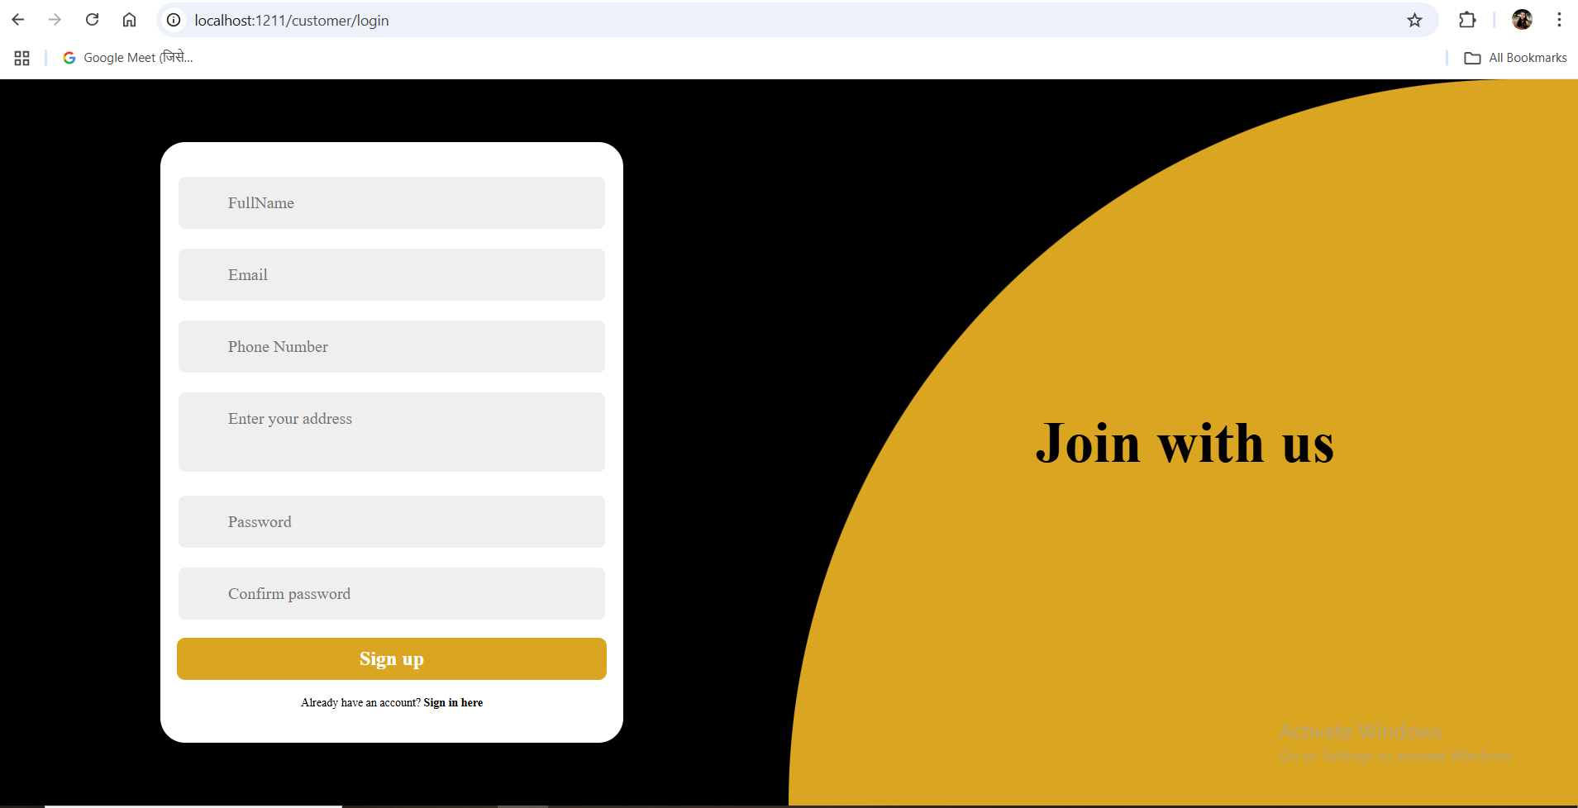
The Sign-up page of Vintronics offers a simple and secure registration process, allowing Users and Admin to create an account effortlessly with essential details and authentication measures.

Slide 12
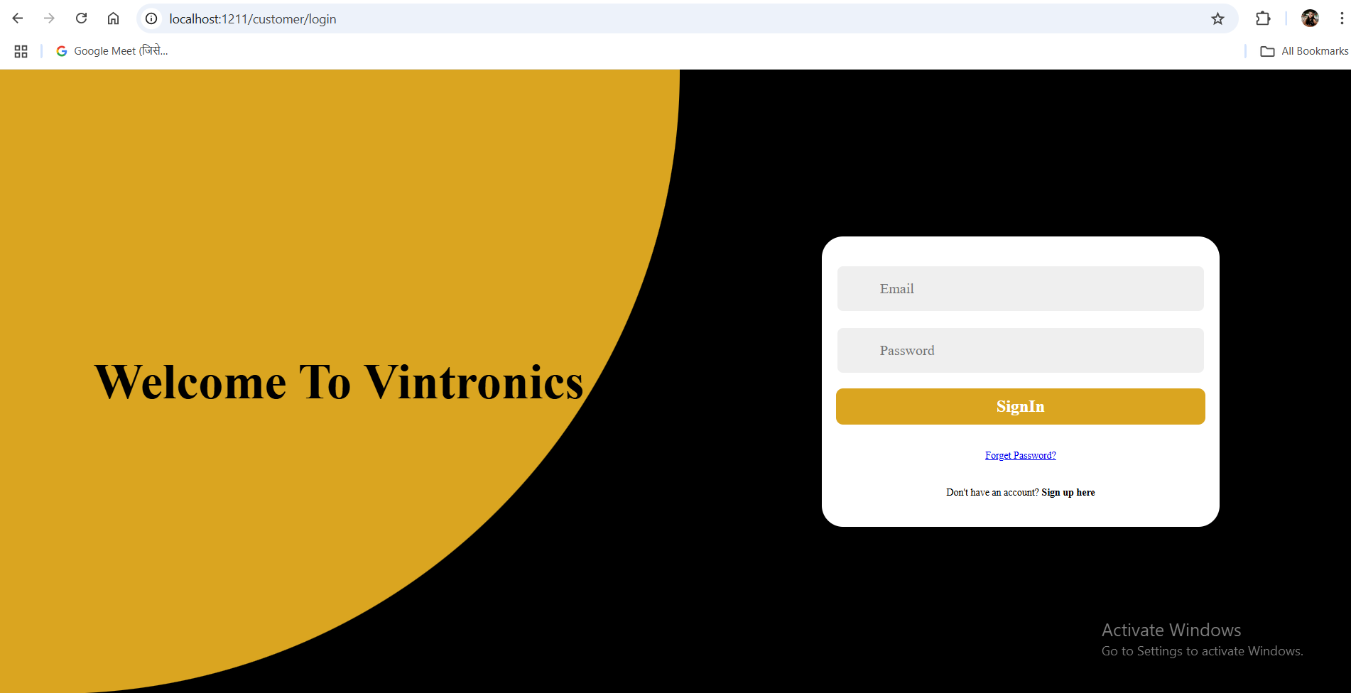
The Login page of Vintronics ensures a secure and seamless Users and Admin authentication process with email/password input, encryption, and optional multi-factor authentication for enhanced security.

Slide 13
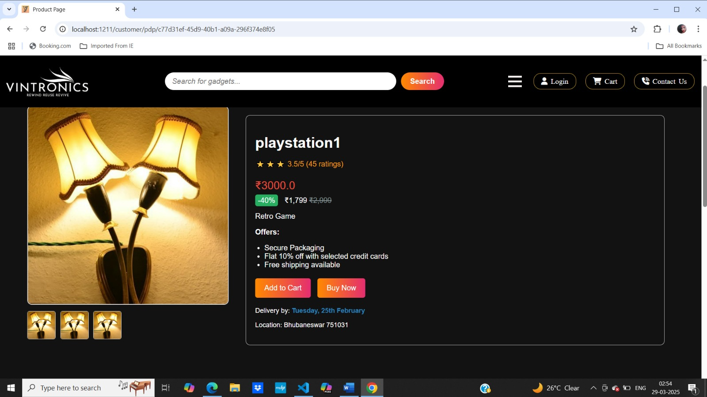
The Product Detail Page (PDP) of Vintronics provides in-depth information about each retro gadget, including high-quality images, specifications, pricing, customer reviews, and a seamless "Add to Cart" option.

Slide 14
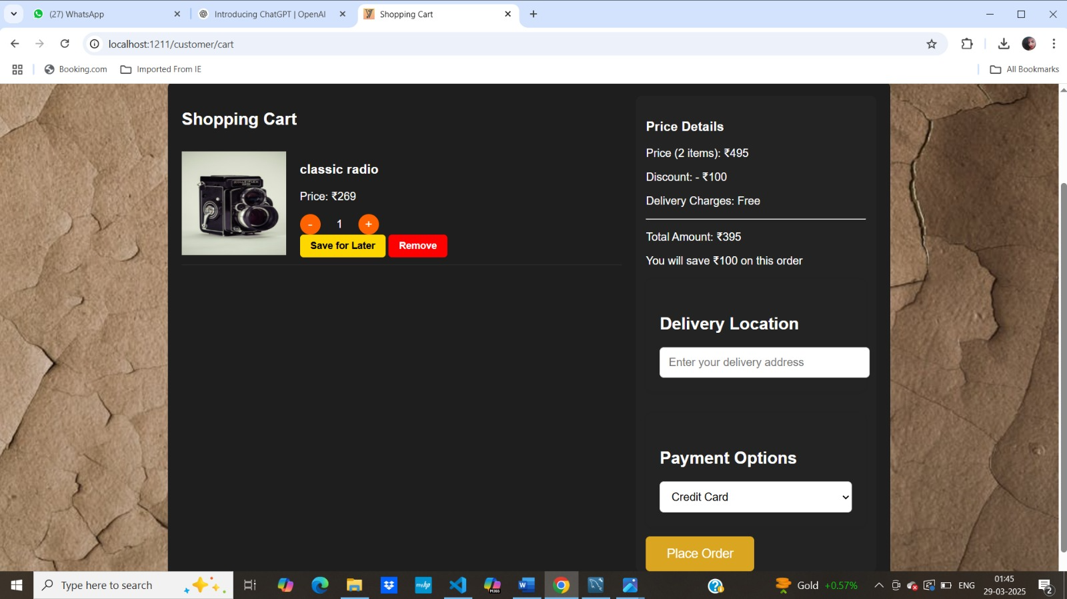
The Cart Page of Vintronics offers a clear and organized view of selected items, allowing users to update quantities, apply discount codes, and proceed to a secure checkout seamlessly.

Slide 15
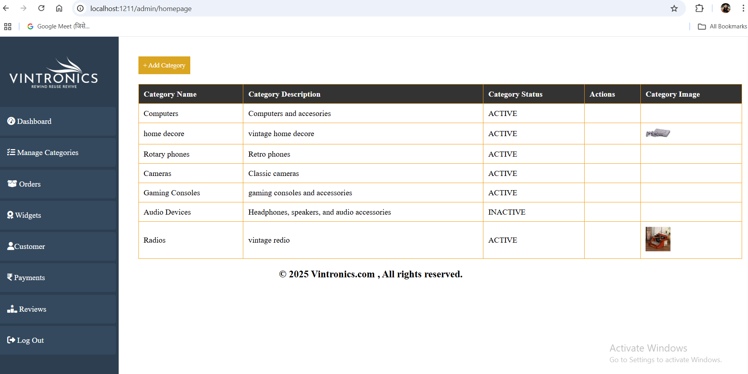
The Admin Dashboard of Vintronics includes a dedicated Category Management section, enabling admins to effortlessly add, update, or remove product categories for an organized and structured product catalog.

Slide 16
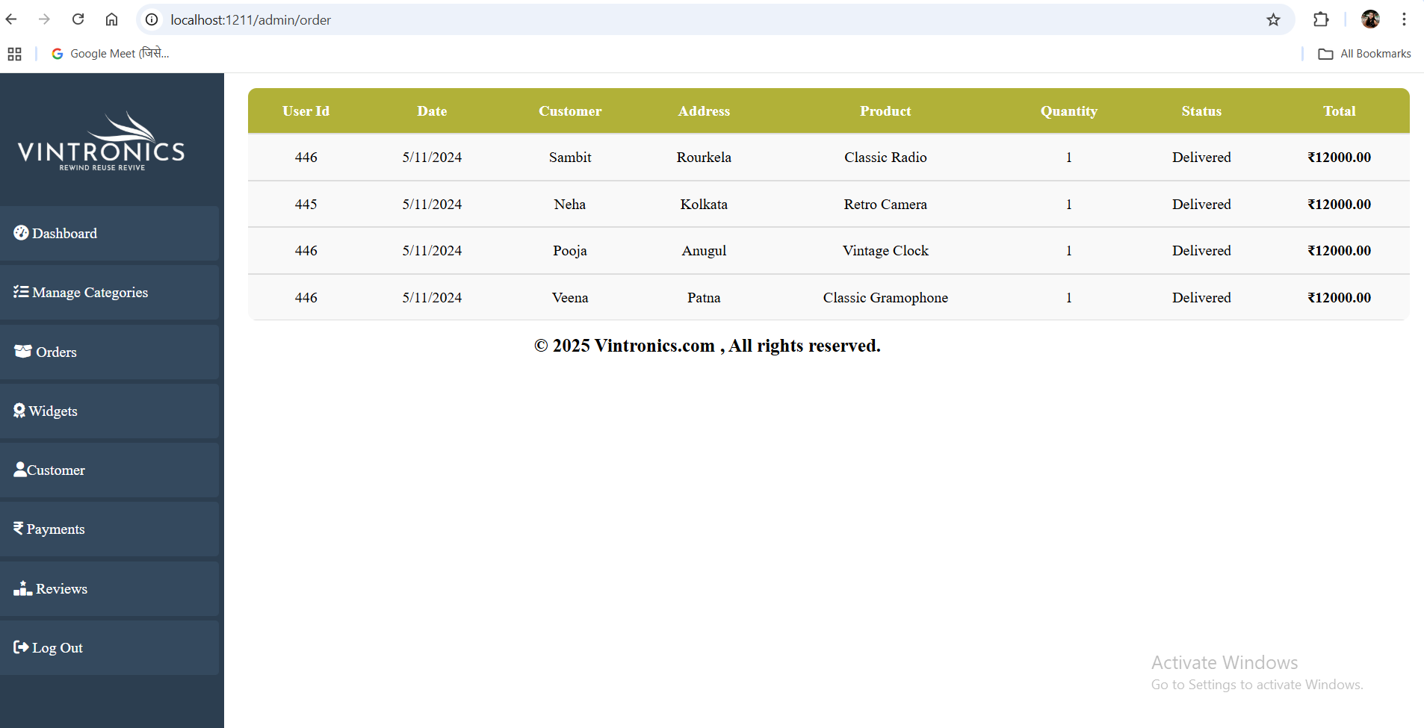
Order Management section of Admin dashboard

Slide 17
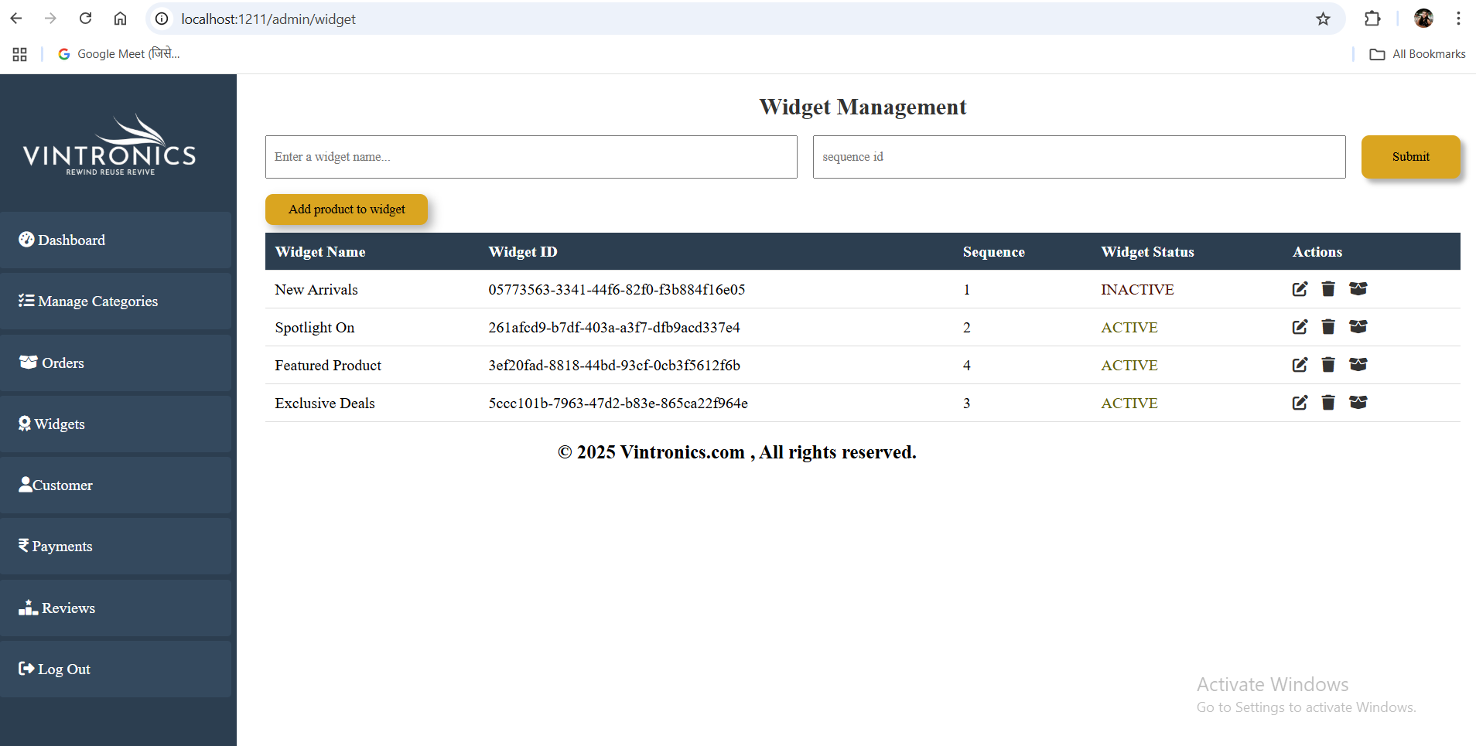
Widget Management section of Admin dashboard

Slide 18
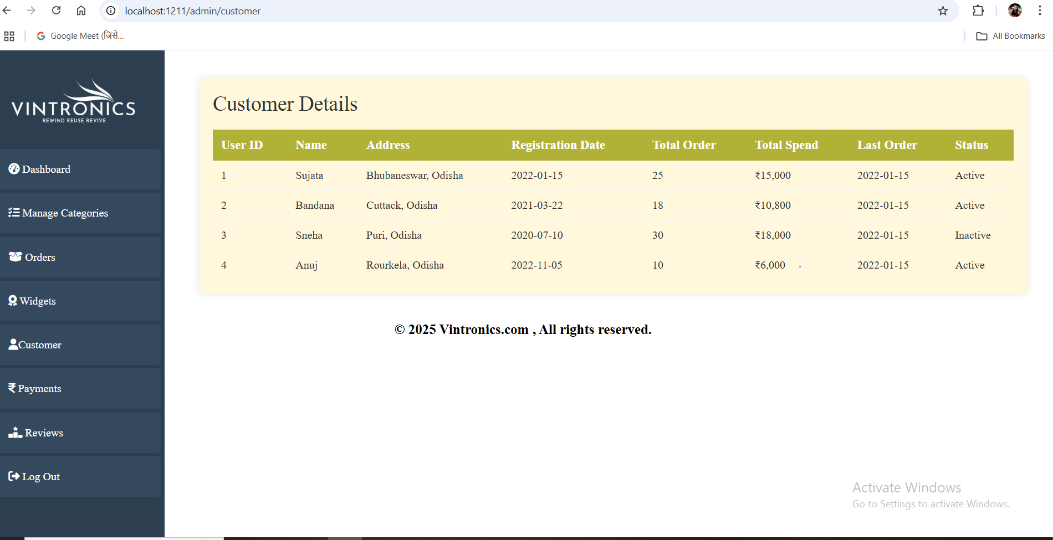
User management section of Admin dashboard

Slide 19
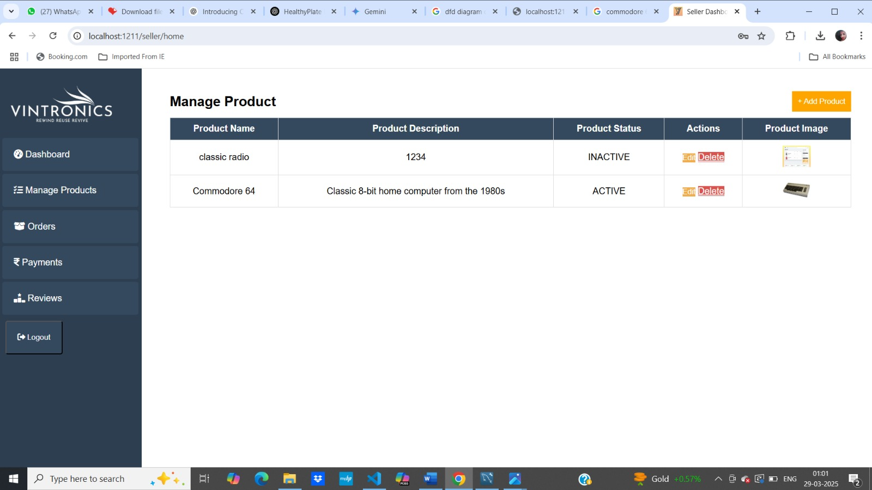
The Seller Dashboard of Vintronics features a dedicated Product Management section, allowing sellers to effortlessly add, edit, or remove products, upload images, set pricing, and manage inventory for a smooth selling experience.

Slide 20
Order Management section of Seller dashboard

Slide 21
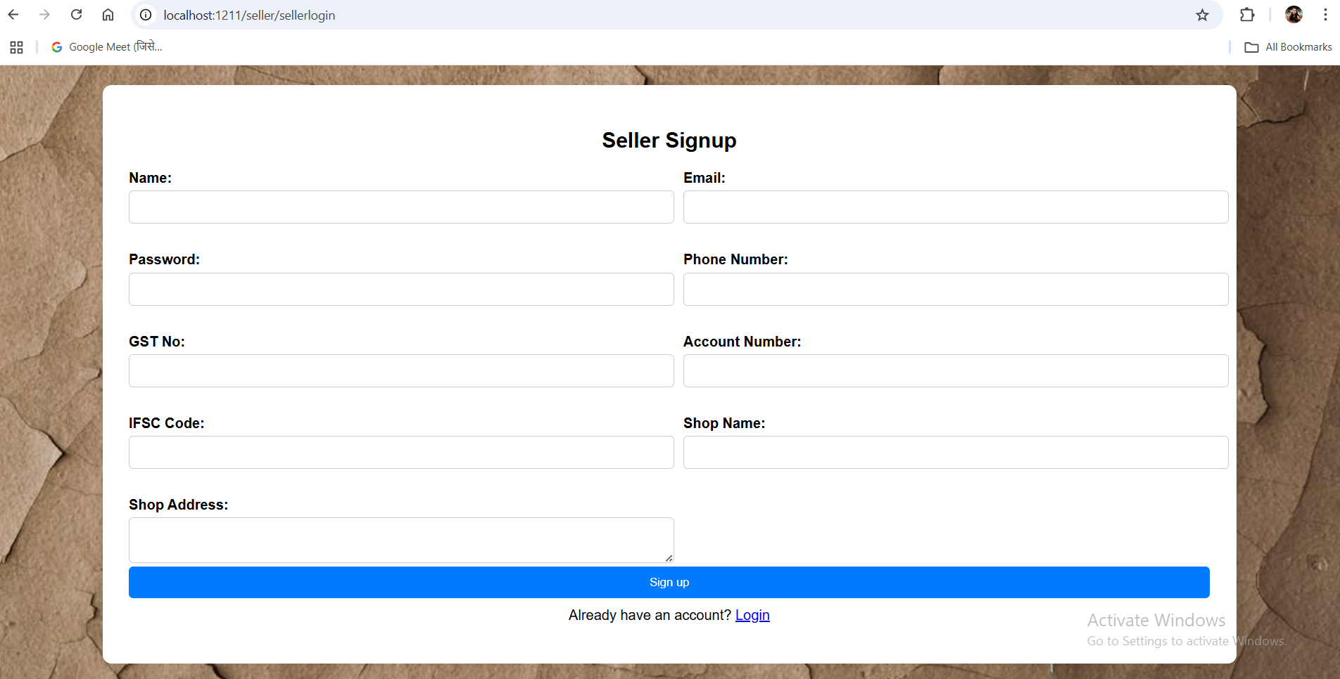
The Seller Sign-Up Page of Vintronics provides a structured registration form where sellers can securely enter their ID, GST number, shop name, address, and other essential details, ensuring a verified onboarding process for a trustworthy marketplace.

Slide 22
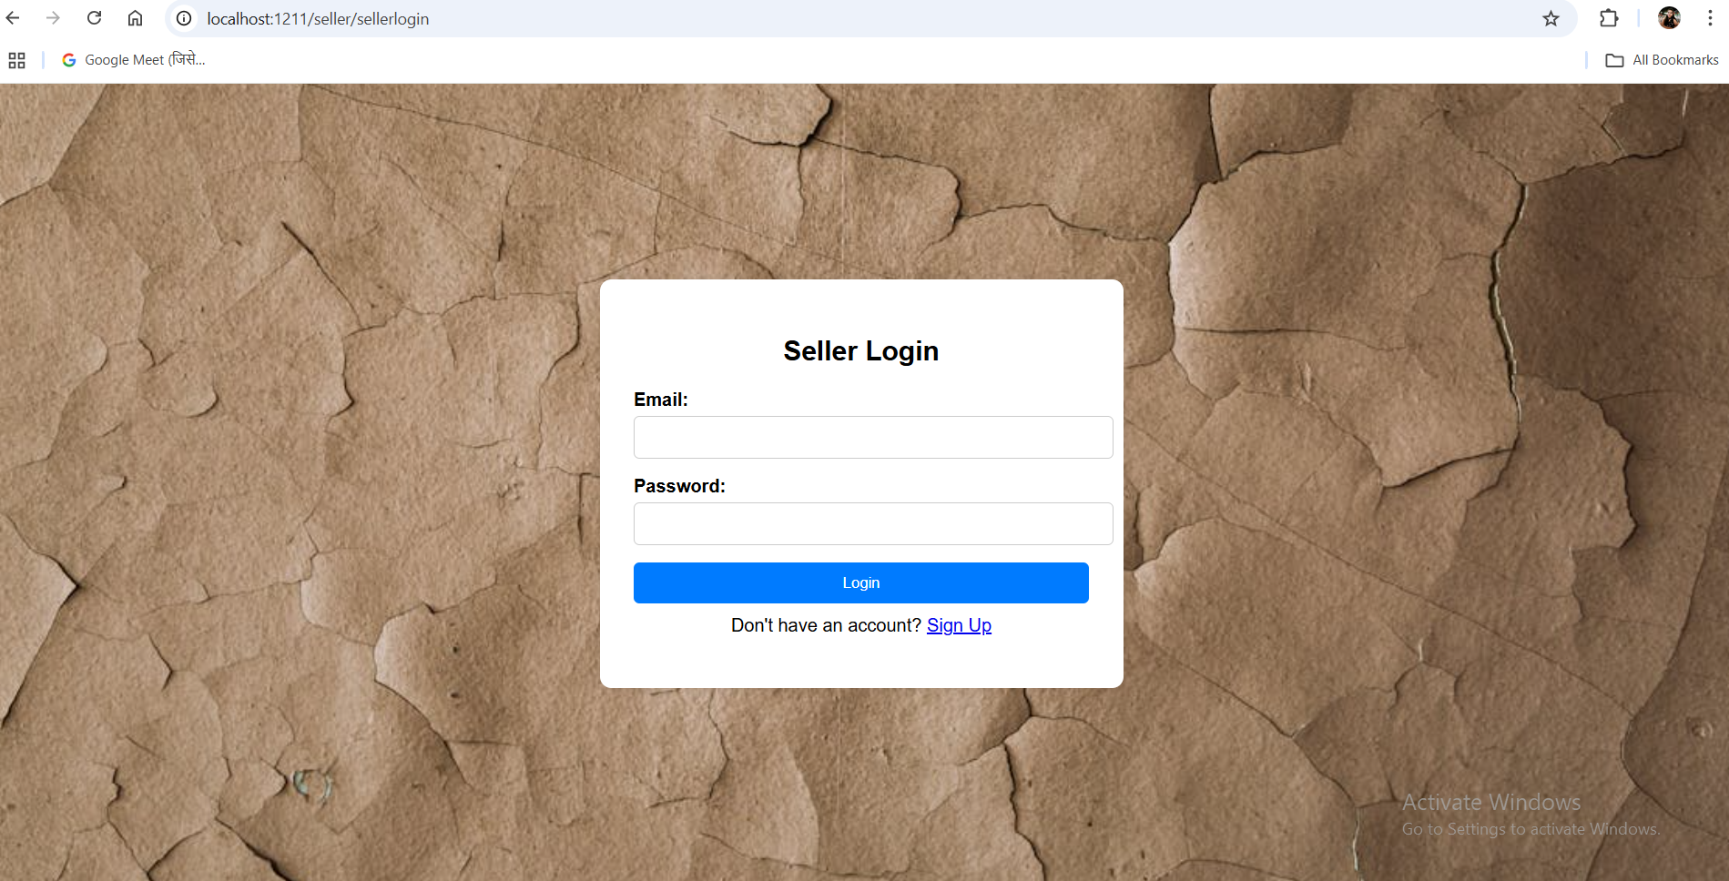
The Seller Login Page of Vintronics offers a secure authentication system, allowing registered sellers to log in using their credentials and access their dashboard to manage products, orders, and sales efficiently.

Slide 23
Future Enhancement
AI-Powered Product Recommendations – Implement machine learning to suggest products based on
user preferences and browsing history.
Chatbot & AI Customer Support – Integrate an AI-driven chatbot for instant query resolution and better
customer assistance.
Blockchain-Based Transaction Security – Enhance security and transparency in transactions using
blockchain technology.
Subscription Model for Exclusive Deals – Offer premium memberships with benefits like early access to
rare products and special discounts.
Integration with Social Media Marketplaces – Allow direct product sharing and selling through platforms
like Instagram and Facebook.
Voice Search Integration – Enhance search functionality with voice commands for easier product discovery.

Slide 24
Challenges and Solutions
1. Ensuring Secure Transactions
Solution: Implement SSL encryption, Spring Security, and secure payment gateways to protect user data and transactions from cyber threats. Enable two-factor authentication (2FA) for added security.
2. Improving Search & Filtering Accuracy
Solution: Implement AI-driven search algorithms, enable category-based filtering, and use natural language processing (NLP) to improve search relevance and accuracy.
3. Inventory & Order Management
Solution: Develop an automated inventory management system with real-time stock updates, low-stock alerts, and an efficient order tracking system to manage product availability.
4. Ensuring Smooth UI/UX Across Devices
Solution: Use CSS media queries, Bootstrap, and responsive design techniques to ensure a seamless and consistent experience across mobile, tablet, and desktop devices.
5. Payment Gateway Failures
Solution: Integrate multiple payment gateways (such as PayPal, Stripe, Razorpay) to prevent failures and implement automatic transaction retry mechanisms in case of errors.

Slide 25
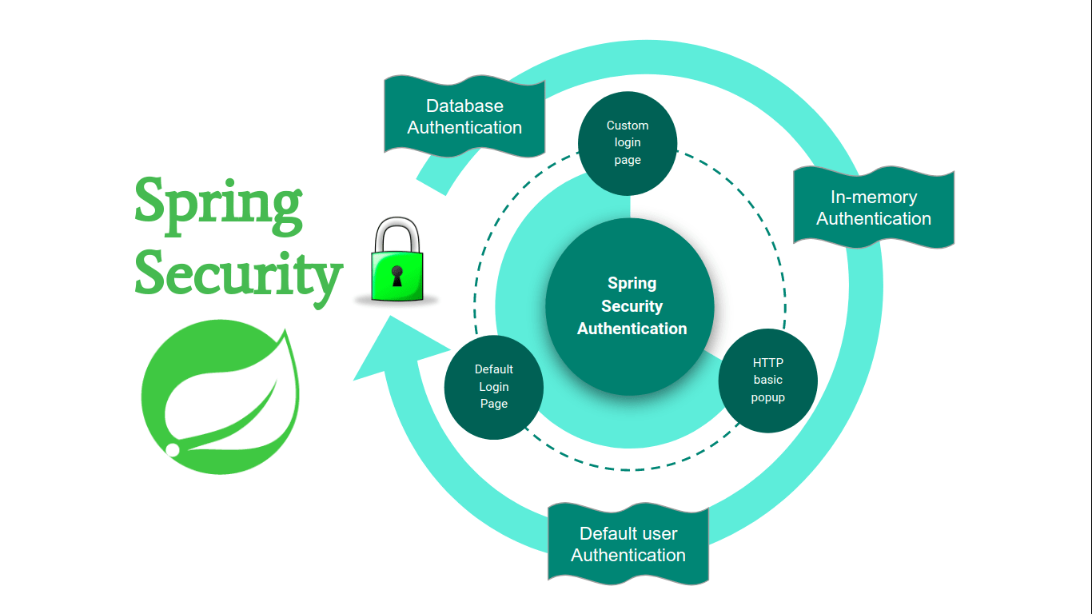
Security Feature
CSRF (Cross-Site Request Forgery): A security attack where unauthorized commands are transmitted
from a trusted user, preventable using CSRF tokens.
SQL Injection: A vulnerability where attackers manipulate SQL queries to access or modify database
data, mitigated using prepared statements and input validation.
Bcrypt Encryption: A hashing algorithm used for securely storing passwords by applying salting and
multiple hashing rounds to protect against brute-force attacks.

Slide 26
User Roles
Admin:-
User Management – Approve, verify, and manage seller registrations while monitoring user activity.
Category Management – Add, update, or remove product categories to keep the marketplace well-organized.
Order & Transaction Monitoring – Track orders, verify payments, and handle disputes or fraudulent activities.
Content Moderation – Review product listings, descriptions, and user reviews to maintain platform integrity.
Security & Compliance – Ensure data privacy, prevent cyber threats (CSRF), and enforce platform policies.
Reports & Analytics – Generate sales reports, analyze user behavior, and optimize platform performance.

Slide 27
Seller:-
Product Management – Add, update, and manage retro gadget listings with descriptions,
images, and pricing.
Inventory Management – Track stock levels and update availability to ensure accurate listings.
Order Processing – Accept, pack, and ship customer orders while ensuring timely delivery.
Customer Interaction – Respond to buyer inquiries, provide product details, and address concerns or disputes.
Sales & Revenue Tracking – Monitor sales performance, view earnings, and manage financial transactions.
Compliance with Platform Policies – Follow the website’s guidelines, ensure product authenticity, and
maintain ethical selling practices.

Slide 28
User:-
Account Management – Register, log in, and update personal details like address and payment information.
Product Browsing & Searching – Explore retro gadgets using filters, categories, and search features.
Order Tracking – View order history, track shipments, and request returns or refunds if needed.
Review & Ratings – Provide feedback on purchased products to help other buyers make informed decisions.
Wishlist & Favorites – Save favorite products for future purchases and easy access.

Slide 29
Conclusion
The Vintronics Retro Gadget E-Commerce Website successfully bridges the gap between vintage tech enthusiasts and sellers by providing a secure, user-friendly, and feature-rich platform. With a robust Spring Boot backend, dynamic frontend using HTML, CSS, and JavaScript, and MySQL for data management, the platform ensures seamless transactions, efficient product management, and enhanced user engagement.
Key features like secure authentication, product categorization, seller verification, and customer reviews make it a reliable marketplace for retro gadgets. Future enhancements such as AI-powered recommendations.
Overall, Vintronics is a well-structured, scalable, and engaging platform that not only preserves vintage technology but also promotes sustainability by encouraging the reuse and resale of classic gadgets.

Slide 30

Thank You.

